Slide 1
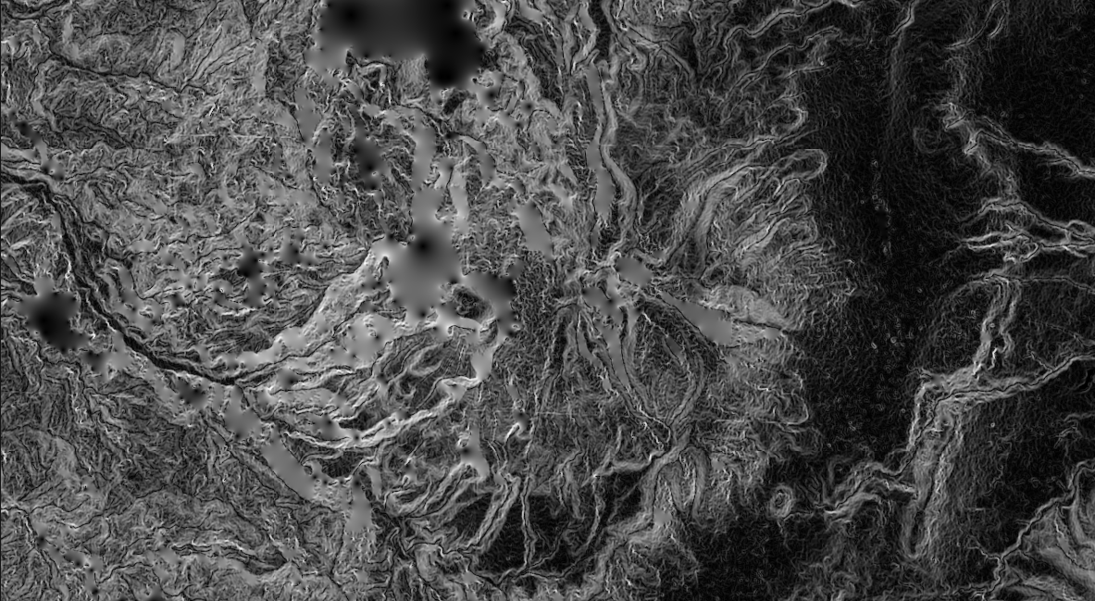
GIS For the Intrepid: Session 3
Presented by Nicholas Barber, 2nd Year PhD Student at the University of Cambridge, U.K.
ndb38@cam.ac.uk | www.volcannick.com | https://github.com/ndb38 | Twitter @volcannick

Slide 2
Workshop Structure
Today: Session 1 – Principles and Motivation for GIS in the Geosciences
Why GIS?
Principles of GIS
Getting acquainted with Quantum GIS?
Wednesday June 17th: Session 2 – Tutorial + Guagua Pichincha Exercise
Tour of Interface
Tutorial
Monday July 6th: Session 3 (GIS for the Intrepid) - Advanced GIS
Frontiers of GIS
Geostatistics
Python
Data Management
Advanced formatting
Wednesday July 8th: Scheduled “TA Hours” for 1-on-1 project advice

Slide 3
Previous Sessions Demonstration:
Planning a project
Finding Data
Defining CRS/PCS
Initial Import + Projection
Georeferencing Images
Tracing Basemaps
Analysis: Geoprocessing, Statistics, Attributes
Visualization and Symbology
Layout Design

Slide 4
Today’s Demonstration
What It Won’t Cover
Advanced Cartography (layout Manager)
LANDSAT Mineral Epxloration
Too big a topic to cover in a 2-hour course ☹
Python in QGIS **in great detail**
I will show functionality, but once you know the basics, the details are self-explanatory

Slide 5
Today’s Demonstration
What It Won’t Cover
Advanced Cartography (layout Manager)
LANDSAT Mineral Epxloration
Too big a topic to cover in a 2 hour course
Python in QGIS **in great detail**
I will show functionality, but once you know the basics, the details are self-explanatory
What It Will Cover
Multiple Data Types Handling/Conversion
CSV + Raster Manipulation
Geostatistics
Raster Statistics + Zonal Statistics
Adavanced Formatting + Symbology
DEM Visualization
Web Database Connections
Basics of Python in QGIS

Slide 6
Let’s Get to It!
Section 2: Advanced Formatting
Line Symbology
Draw Effects
Heatmaps
Raster Viz.
3D Viewer
Section 3: Final Topics
Spatial Database Connections
Basics of Python
Section 1: Advanced Analysis
Exercise 2: Fluid Geochemistry of G.P.
Importing CSVs
Spatial Joins
Interpolating Point Shapefiles
Exercise 3: Landslide Risk near Quito
Raster Statistics
Rasterizing a Shapefile
Raster Calculator
Zonal Statistics
5 Minute break?

Slide 7
Section 1

Slide 8
Section 2

Slide 9
Section 3

Slide 10
Final Thoughts

Slide 11
My goals at the start:
Highlight what GIS can do for geoscientists
Outline the key principles of a geographic information system
Providing a fully guided GIS workflow template
Identify key areas of growth for GIS in geoscience research

Slide 12
If you take nothing else away from this workshop….
GIS is a helpful tool in your workflow if you have data with a spatial dimension
GIS software lets you store, collect, analyze, and share spatial data
Modern GIS platforms like ArcMap and QGIS are all around workhorses – essential to tasks like spatial modeling, database management, cartography, geodesy, data visualization, hazard mitigation, and story telling
Learning the capabilities of GIS is acquired from repeated, often frustrating, trial and error with the hundreds of built-in tools
Studies should be designed with the GIS end user in mind!!!

